Slide 1
Convolutional neural network
Date: 13.09.2022

Slide 2
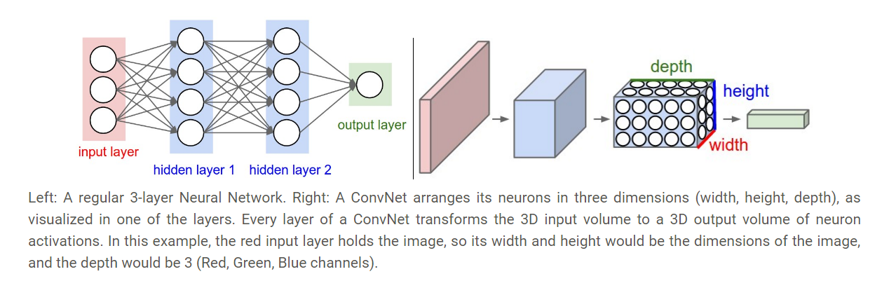
Dense neural network and Convolutional neural network

Slide 3
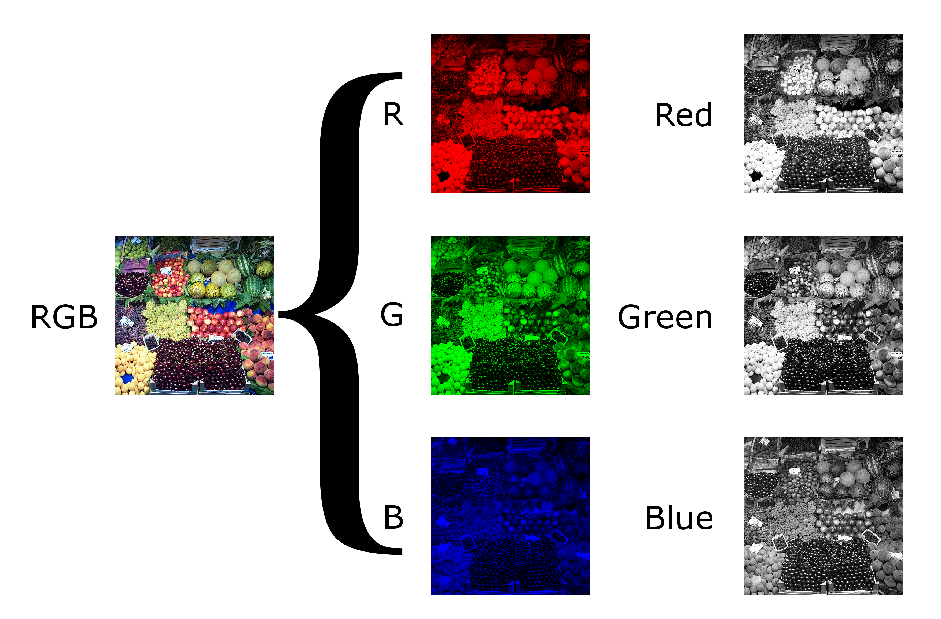
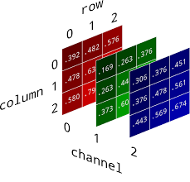
Gray scale vs color image

Slide 4
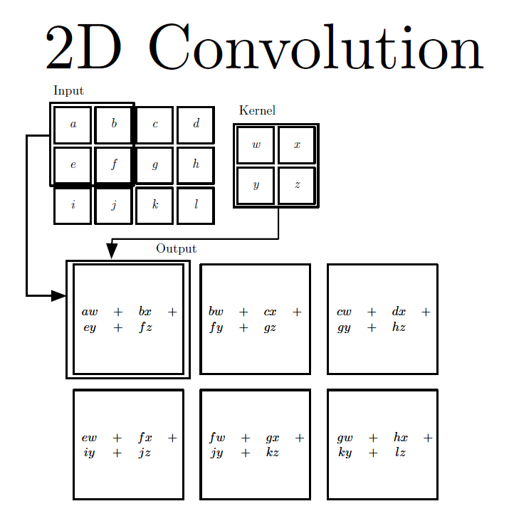

Slide 5
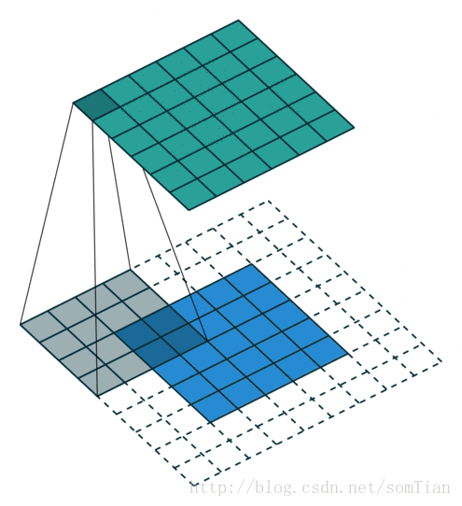
Convolutional kernel

Slide 6
Convolution
1 | -1 | -1
-1 | 1 | -1
-1 | -1 | 1
Filter 1
stride=1
1 | 0 | 0 | 0 | 0 | 1
0 | 1 | 0 | 0 | 1 | 0
0 | 0 | 1 | 1 | 0 | 0
1 | 0 | 0 | 0 | 1 | 0
0 | 1 | 0 | 0 | 1 | 0
0 | 0 | 1 | 0 | 1 | 0
Dot
product
3
-1
6 x 6 image

Slide 7
Convolution
1 | -1 | -1
-1 | 1 | -1
-1 | -1 | 1
Filter 1
If stride=2
1 | 0 | 0 | 0 | 0 | 1
0 | 1 | 0 | 0 | 1 | 0
0 | 0 | 1 | 1 | 0 | 0
1 | 0 | 0 | 0 | 1 | 0
0 | 1 | 0 | 0 | 1 | 0
0 | 0 | 1 | 0 | 1 | 0
3
-3
Importance of stride:
Less overlaps between the image pixels and filter mask
Less output volume
6 x 6 image

Slide 8
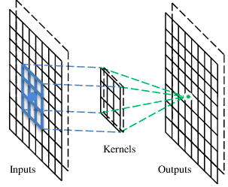
A convolutional layer
A CNN is a neural network with some convolutional layers
(and some other layers). A convolutional layer has a number
of filters that does convolutional operation.
Kernel
A filter

Slide 9
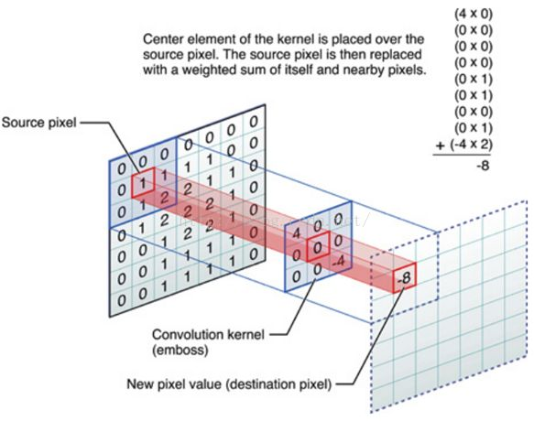
Convolutional kernel

Slide 10
Convolution
These are the network parameters to be learned.
1 | -1 | -1
-1 | 1 | -1
-1 | -1 | 1
1 | 0 | 0 | 0 | 0 | 1
0 | 1 | 0 | 0 | 1 | 0
0 | 0 | 1 | 1 | 0 | 0
1 | 0 | 0 | 0 | 1 | 0
0 | 1 | 0 | 0 | 1 | 0
0 | 0 | 1 | 0 | 1 | 0
Filter 1
-1 | 1 | -1
-1 | 1 | -1
-1 | 1 | -1
Filter 2
……
6 x 6 image
Each filter detects a small pattern (3 x 3).

Slide 11


Consider learning an image:
Some patterns are much smaller than the whole image
Can represent a small region with fewer parameters
“beak” detector

Slide 12
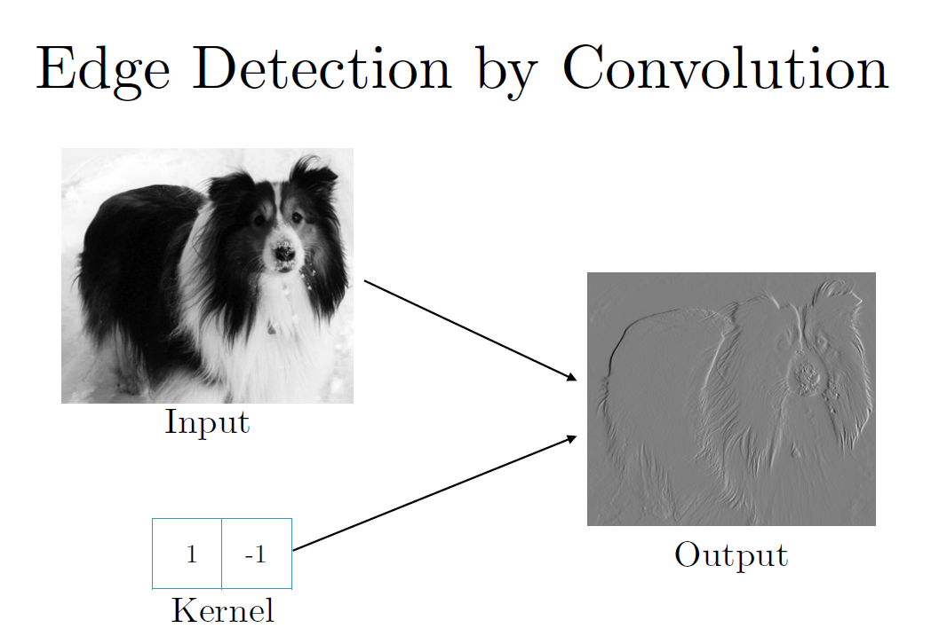
1=edge
-1= not edge

Slide 13
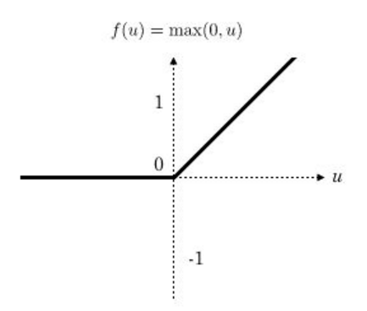
Rectified linear unit，ReLU

Slide 14
Pooling:
The main purpose of pooling layer is to progressively reduce the spatial size of the input image, so that number of computations in the network are reduced. Pooling performs downsampling by reducing the size and sends only the important data to next layers in CNN.
Types: max pooing,min pooling,average pooling
Pooling layer is responsible to retain important information in an image.

Slide 15
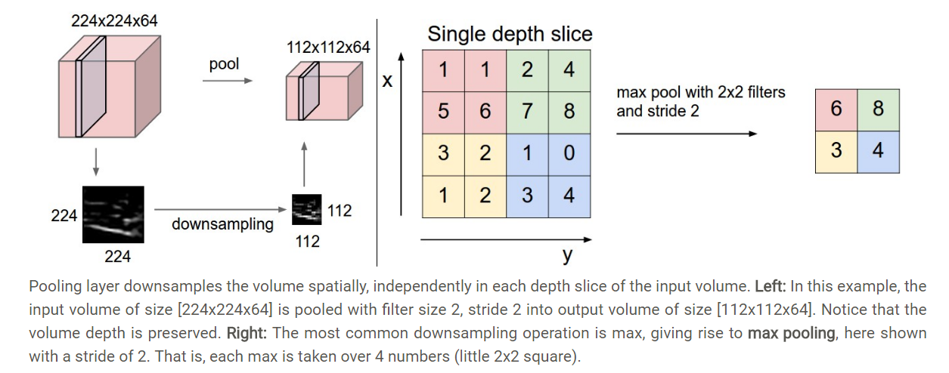
Pooling layer

Slide 16
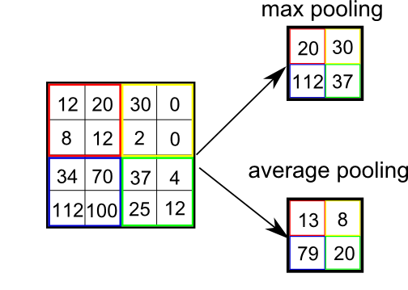
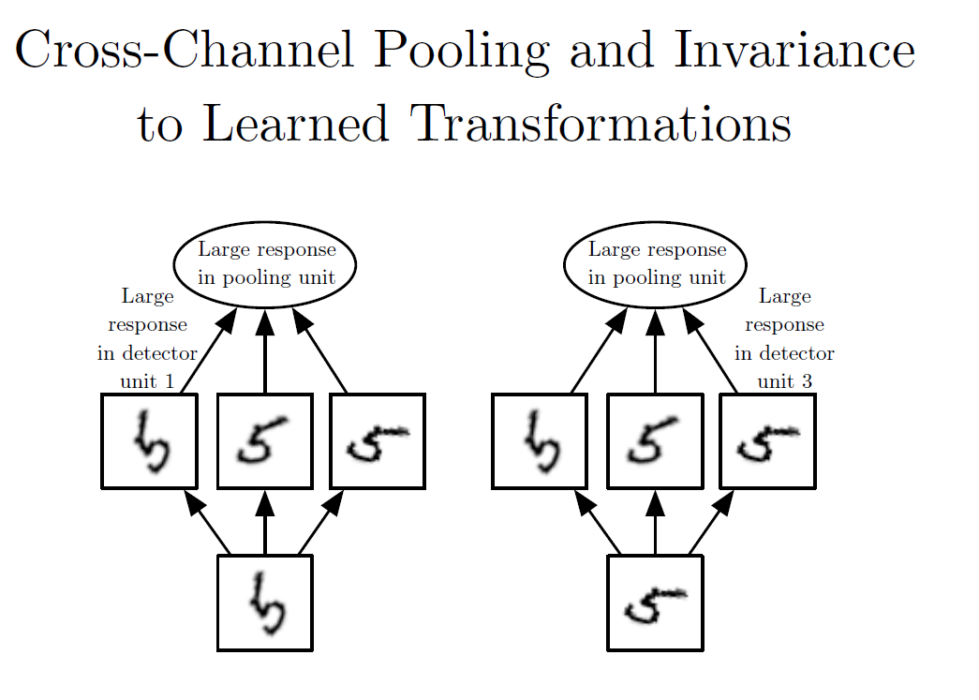
Pooling

Slide 17
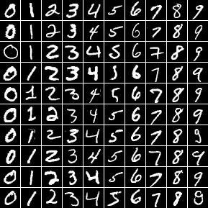
MNIST dataset
The MNIST database of handwritten digits,
available from this page,
has a training set of 60,000 examples, and a test set of 10,000 examples.
It is a subset of a larger set available from NIST.
The digits have been size-normalized and centered in a fixed-size image.

Slide 18
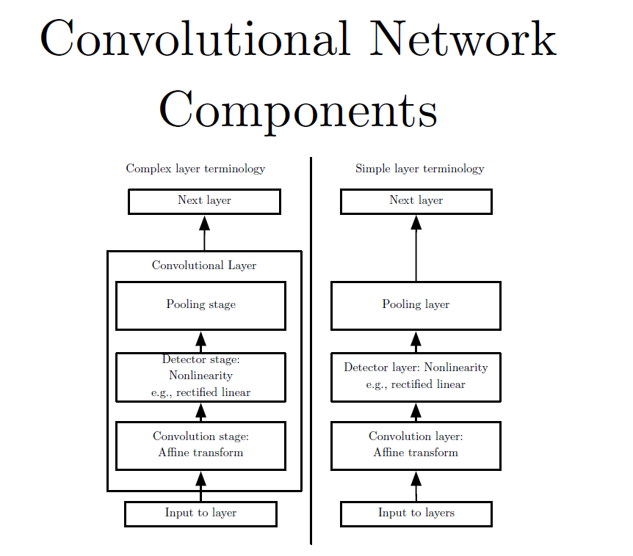

Slide 19
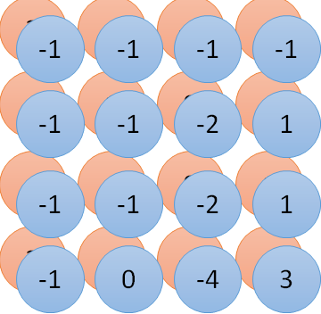
Convolution v.s. Fully Connected
1 | 0 | 0 | 0 | 0 | 1
0 | 1 | 0 | 0 | 1 | 0
0 | 0 | 1 | 1 | 0 | 0
1 | 0 | 0 | 0 | 1 | 0
0 | 1 | 0 | 0 | 1 | 0
0 | 0 | 1 | 0 | 1 | 0
1 | -1 | -1
-1 | 1 | -1
-1 | -1 | 1
-1 | 1 | -1
-1 | 1 | -1
-1 | 1 | -1
convolution
image
1 | 0 | 0 | 0 | 0 | 1
0 | 1 | 0 | 0 | 1 | 0
0 | 0 | 1 | 1 | 0 | 0
1 | 0 | 0 | 0 | 1 | 0
0 | 1 | 0 | 0 | 1 | 0
0 | 0 | 1 | 0 | 1 | 0
……
……
Final image after set of convolution operations
Fully-connected

Slide 20
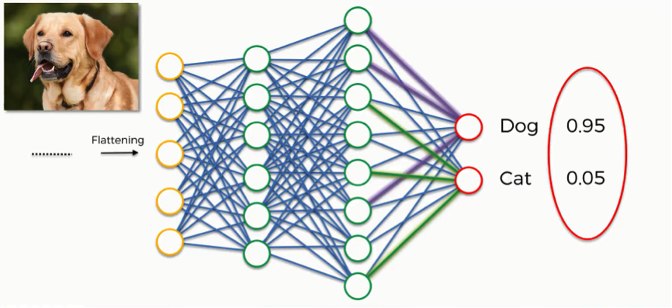
Softmax unit:
The softmax function is often used as the last activation function of a neural network to normalize the output of a network to a probability distribution over predicted output classes

Slide 21

Final block diagram of CNN

Slide 22

0.001
0.11
0.12
0.101
0.80→ 4 will be activated
0.13
0.113
0.14
0.15
0.12
softmax

Slide 23
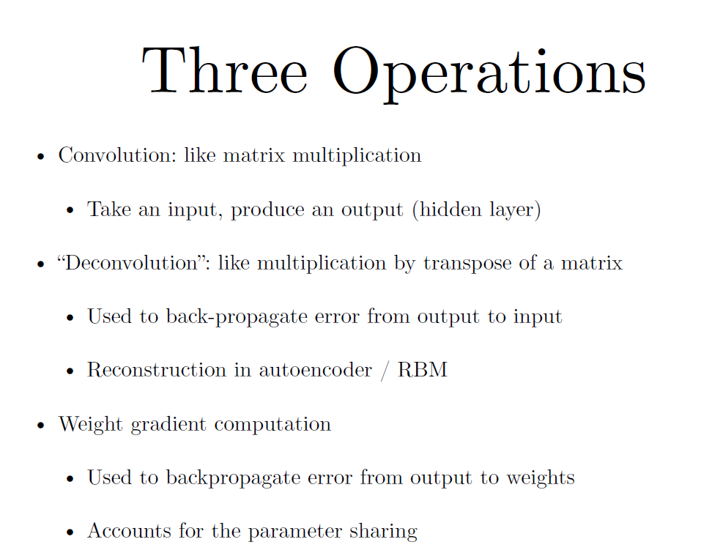
To be covered:

Slide 24
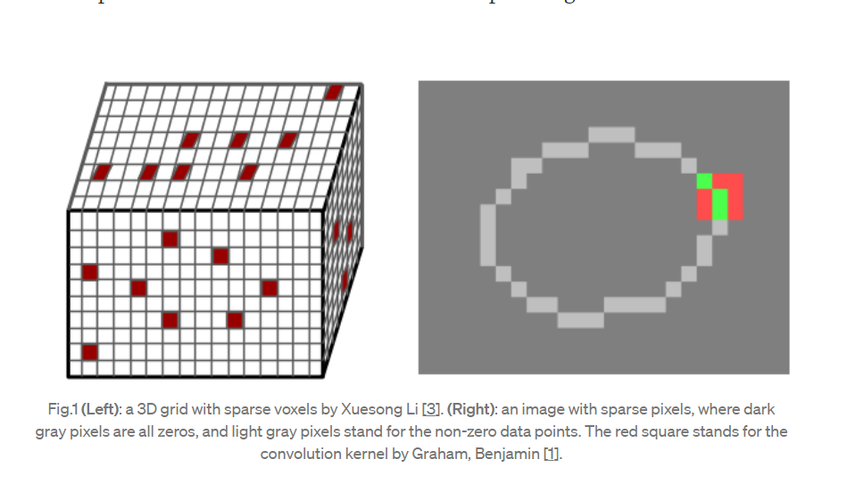
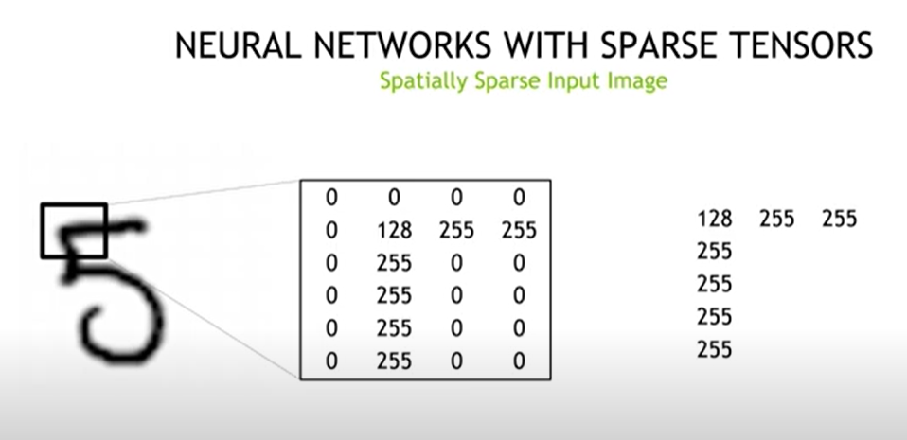
Sparsely connected image matrix

Slide 25
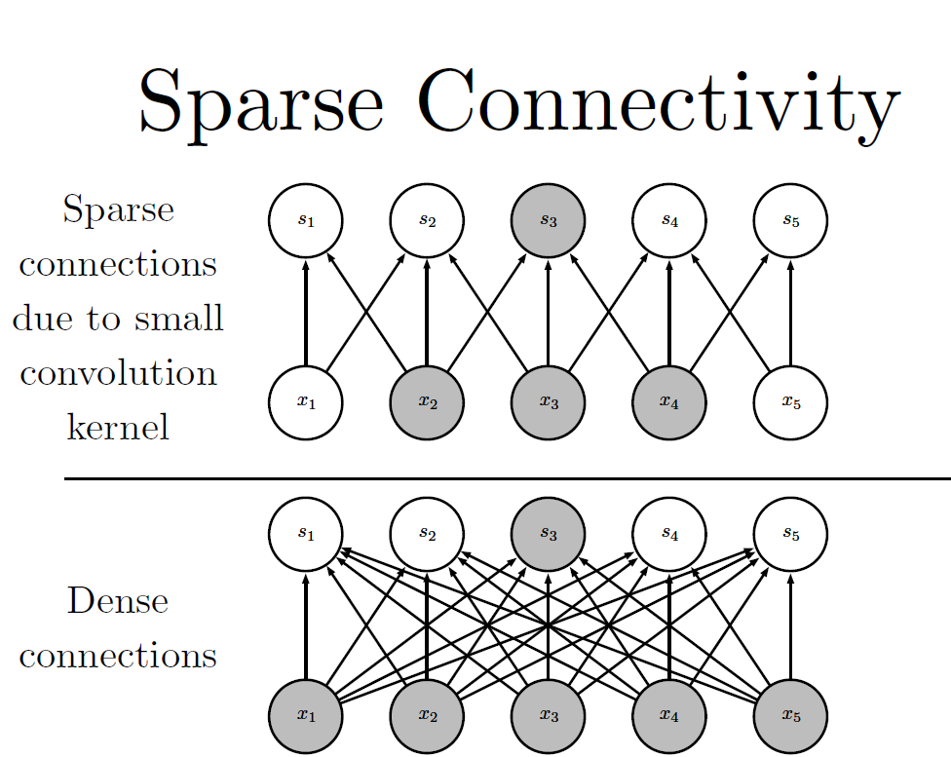

Slide 26
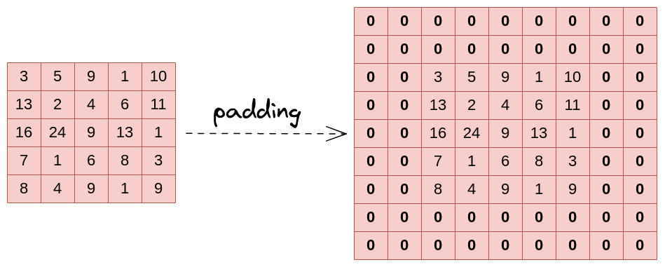
Padding
In a convolutional layer, we observe that the pixels located on the corners and the edges are used much less than those in the middle.
Here we applied padding(p) =2
Initial image size(HxW) = 5x5
After padding the image size will be : (H+2p)x(W+2p)= 9x9 in this case

Slide 27
Important Formula
Given an input image of size (NxN) ,kernel size (KxK) and padding =P and Stride =S
The output image size after one convolution will be:
[(N−K+2P)/S]+1

Slide 28
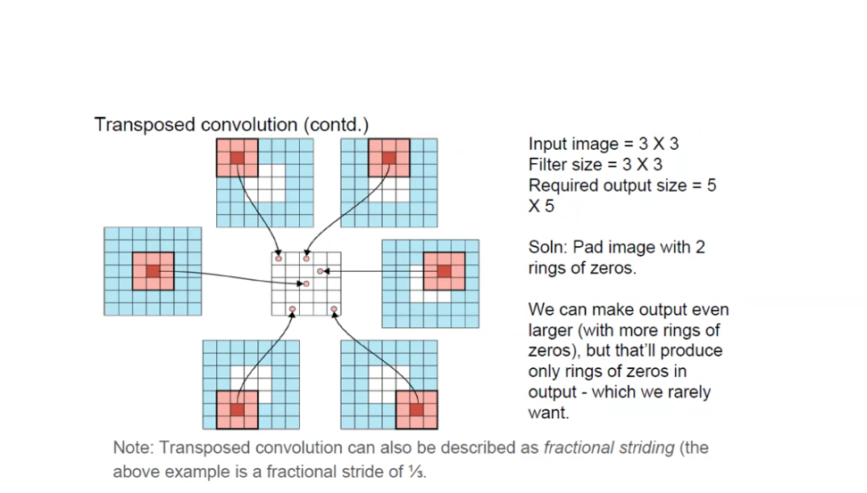
Transposed Convolution:
A technique to make output size larger than input.
Also comes under “Upsampling” techniques.
Upsampling using Transposed convolution increases image resolution. Ex: from 100x100 to 300x300 pixels

Slide 29
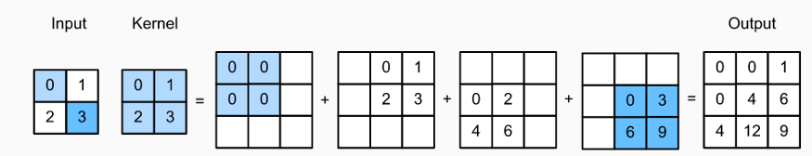
Example:

Slide 30
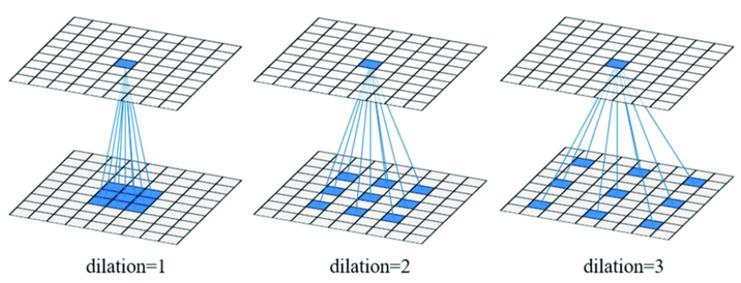
Dilated convolution
Another way to get larger output size is to spread out input images by inserting padding –both around and between input elements.
This is called Dilated convolution.

Slide 31
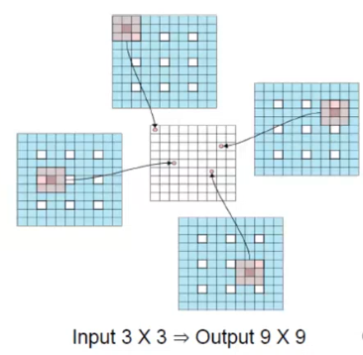
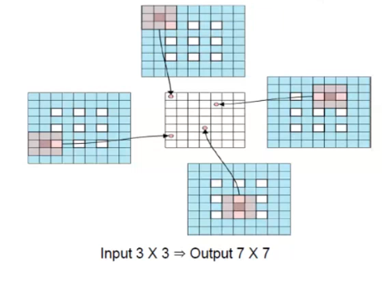
Let’s say we have a 3x3 input image.
Rather than putting 3x3 image as a whole, we split the image into individual pixels and add padding between the pixels and along the boundaries as well.

Slide 32
Convolution Algorithm:
1. Stride convolution
2. Padding convolution
3.Transposed convolution
4. Dilated Convolution

Slide 33
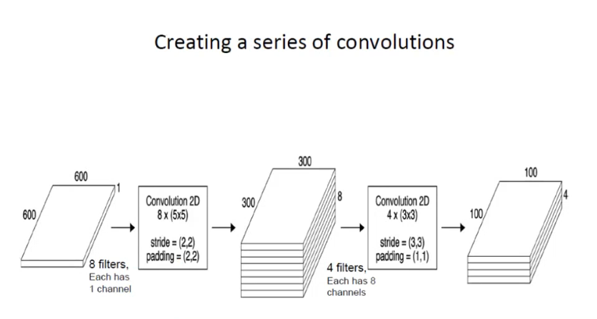
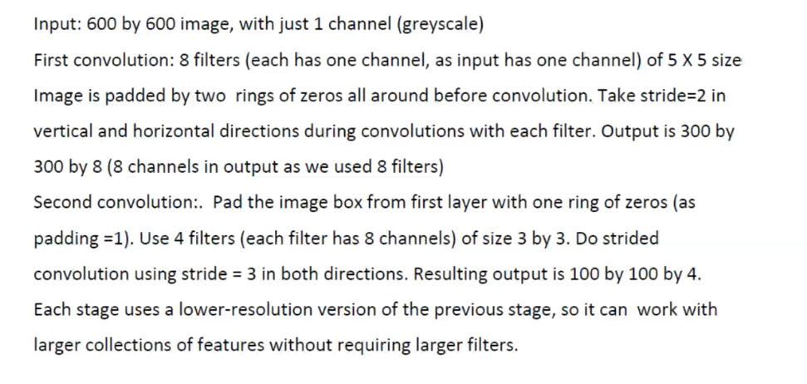

Slide 34
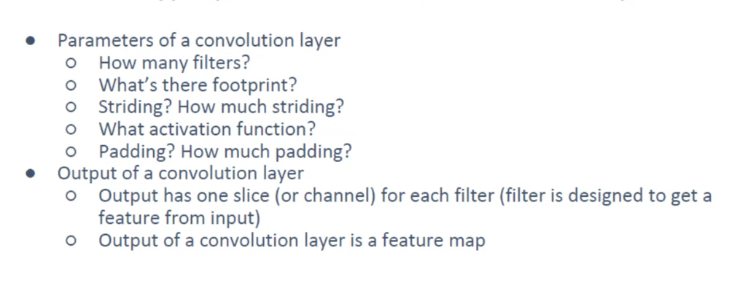
Parameter setting:
Besides this other parameters are learning rate, loss function, batch size, initial weights also to be chosen according to the problem

Slide 35
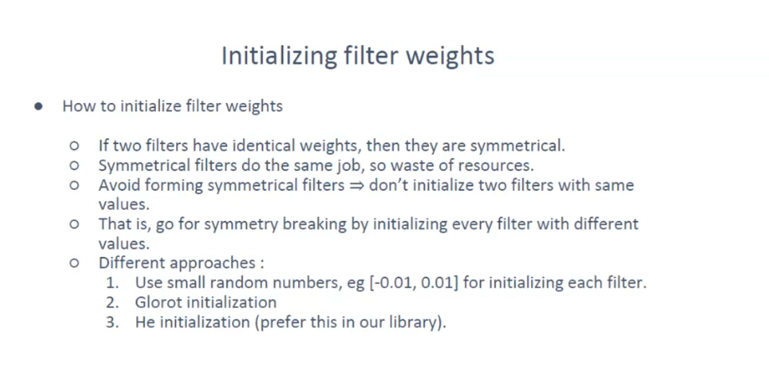

Slide 36
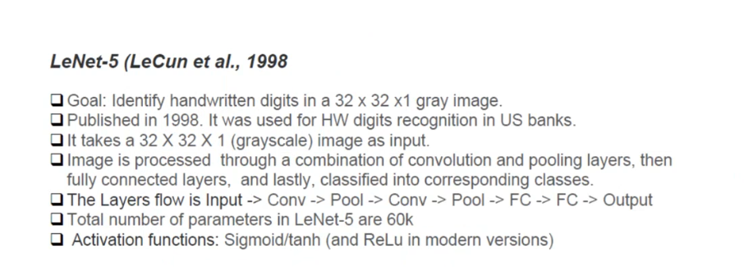
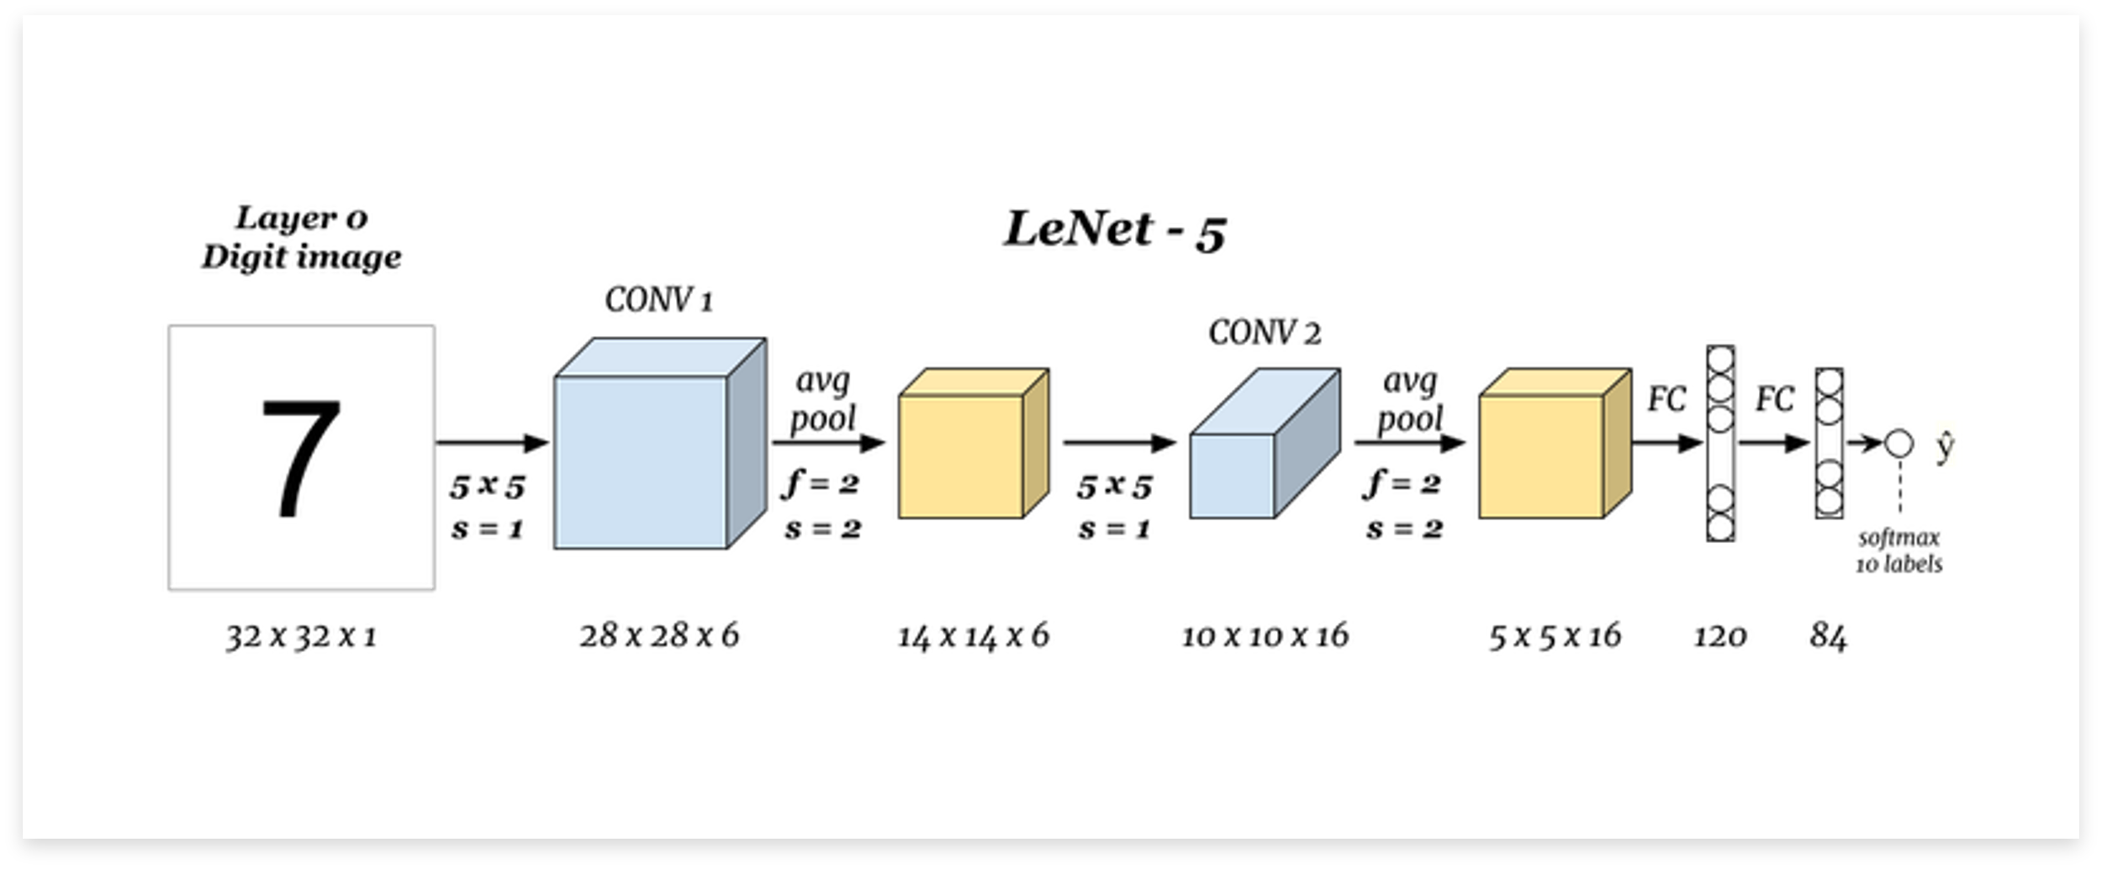

Slide 37
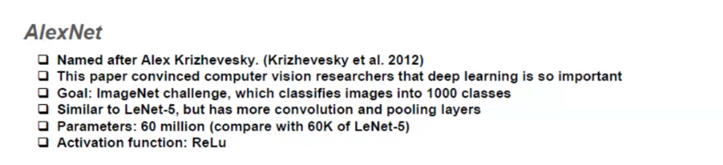
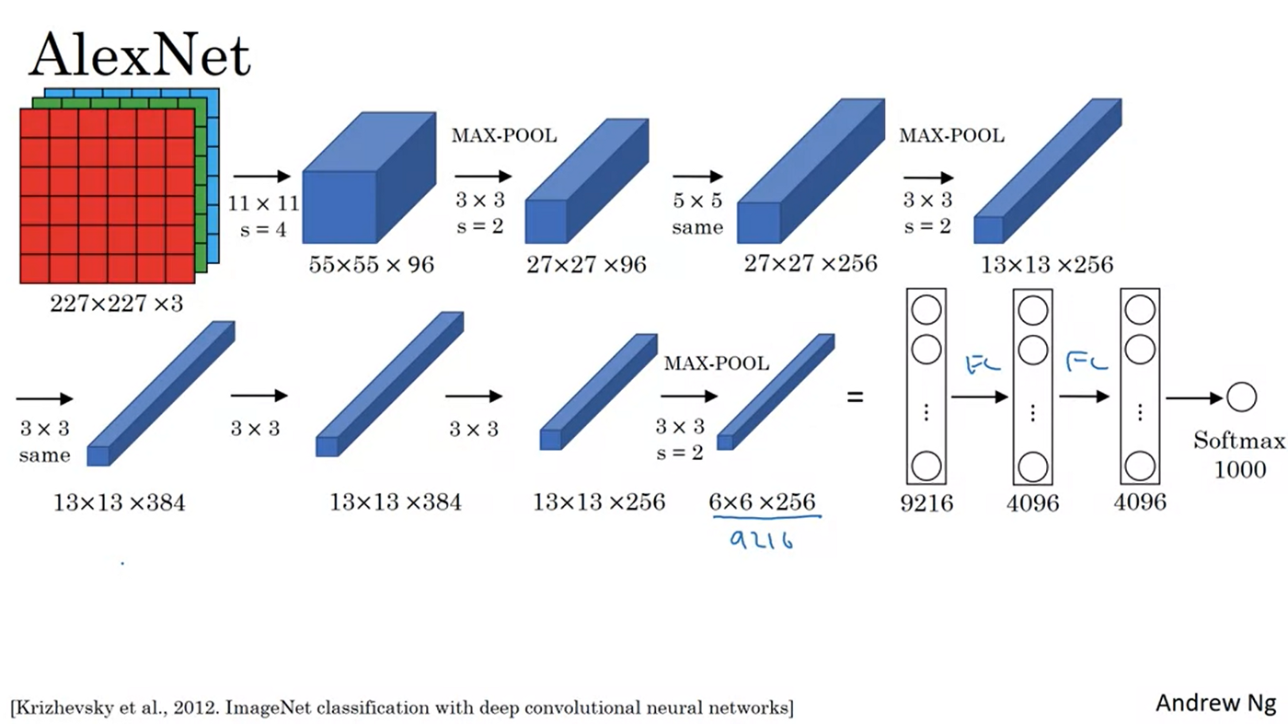

Slide 38
